Slide 1


Strategies and Tools for Talking About Vaccines
Vermont Vaccine Coalition Meeting – February 2026
vaccinateyourfamily.org

Slide 2

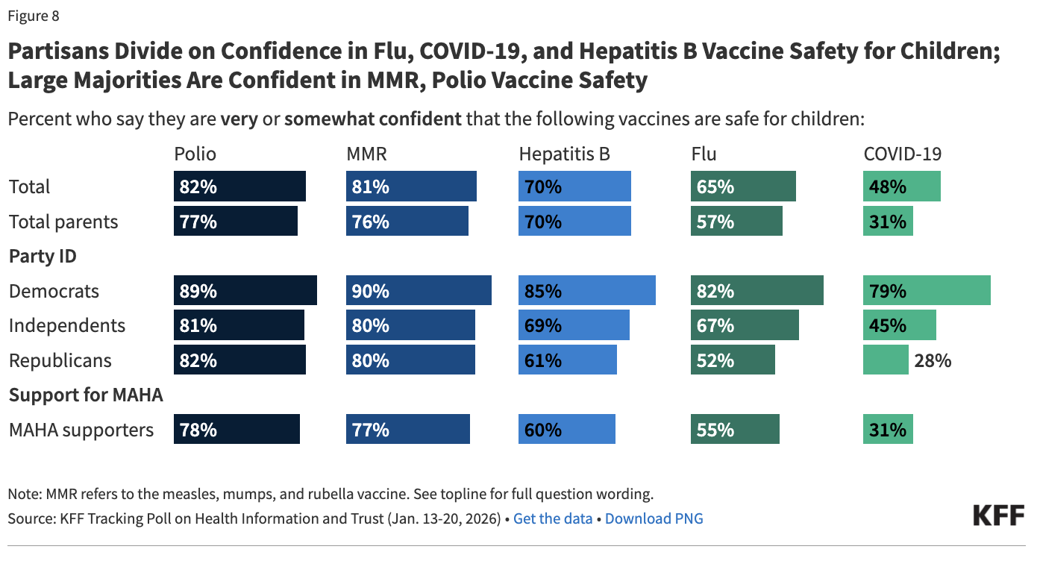
STRATEGIES AND TOOLS FOR TALKING ABOUT VACCINES
The Vaccine Policy and Communication Landscape is Changing Fast
The reconstituted ACIP (summer 2025) and announced changes to the childhood immunization schedule (Jan. 5, 2026) contribute to growing confusion around vaccine decisions.
Still, most parents choose to vaccinate, and most feel confident in the safety of vaccines.
vaccinateyourfamily.org

Slide 3


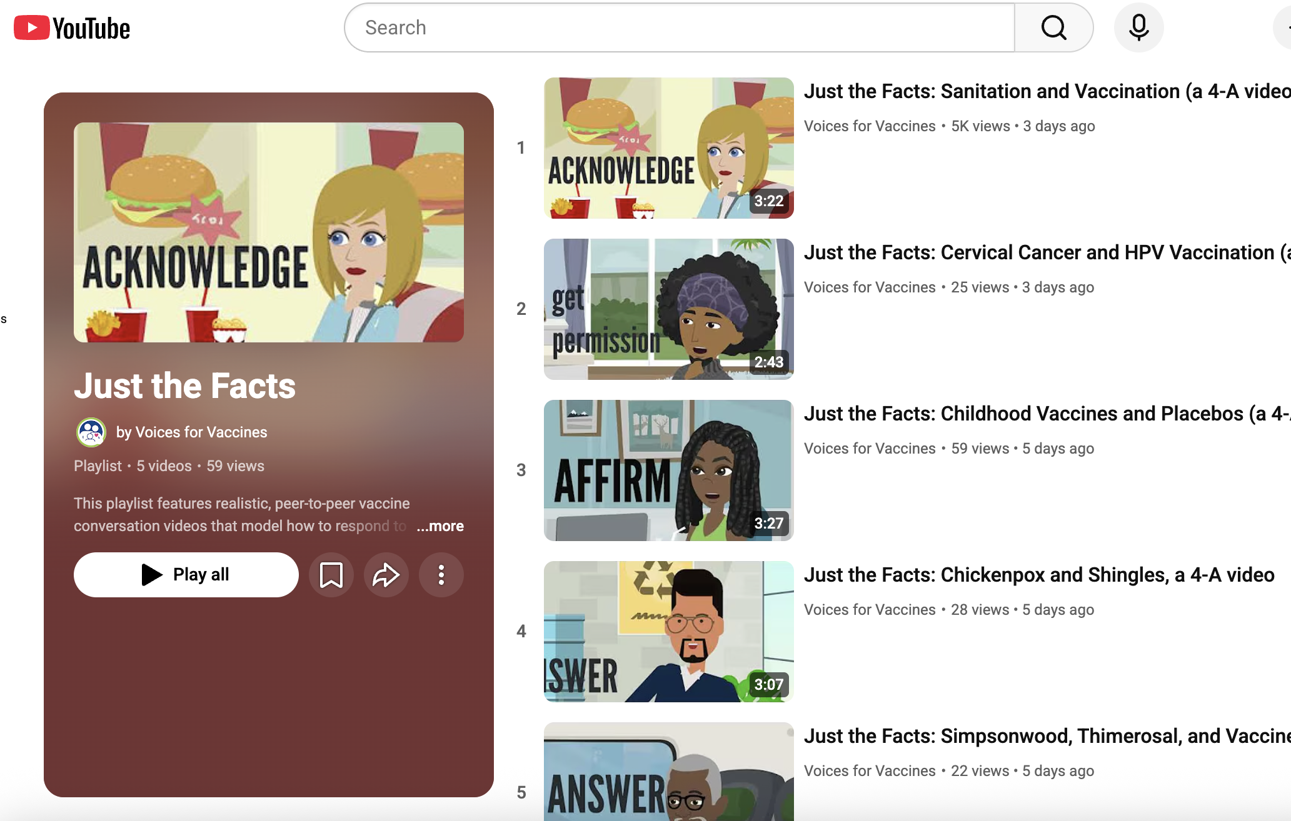
STRATEGIES AND TOOLS FOR TALKING ABOUT VACCINES
The 4-A Method
ASK
ACKNOWLEDGE
AFFIRM
ANSWER
Reduce defensiveness and build trust
Explore the underlying concern before correcting misinformation
Affirm values and questions without validating false claims
Provide clear, permission-based, evidence-grounded responses
Source: Voices For Vaccines
Watch on YouTube: https://youtu.be/rshyEP2Dajs?si=7H_OyxJ3TNDmwO_y

Slide 4
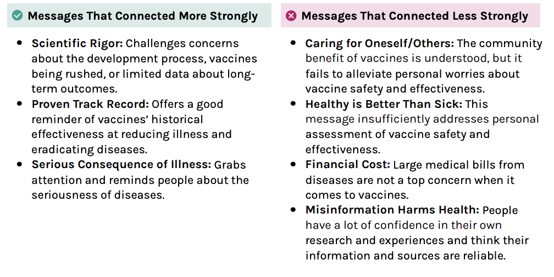
STRATEGIES AND TOOLS FOR TALKING ABOUT VACCINES
Communicating More Effectively About Vaccines
Source: Public Health Communications Collaborative
Available for download here.
vaccinateyourfamily.org

Slide 6
STRATEGIES AND TOOLS FOR TALKING ABOUT VACCINES
Tips for Discussing HHS’s January Changes to the Childhood IZ Schedule
Name the process failure clearly – these changes were not made based on any new safety risks or data, and circumvented our systems designed make sure that federal vaccine recommendations are based on the best information available
Highlight health outcomes, not number of vaccines
Push back on “U.S. outlier” framing and contextualize the schedules of other countries (like Denmark)
Emphasize that clinicians are already having conversations with patients about vaccines to guide discussions based on benefit and risk, and that CDC recommendations are not mandates
Remind that vaccines are still available and recommended by medical experts (your own expertise, the state of Vermont, AAP, ACOG, AAFP, etc.)
Source: The Evidence Collective “In Response: Routine Childhood Vaccination Schedule Change”
Available for download here.
vaccinateyourfamily.org

Slide 7

STRATEGIES AND TOOLS FOR TALKING ABOUT VACCINES
Make it personal!
Share that you have chosen to vaccinate yourself or your children and why.
Share what you have seen in your experience – for example, the many children who have been safely vaccinated, or unvaccinated children with VPDs.

Slide 8




VACCINE COMMUNICATION RESOURCES
Staying Up To Speed on the Vaccine Landscape
The Vaccine Intelligence Report
IZExpress
Trusted Substacks
Health Media Newsletters
A weekly newsletter from Immunize.org to stay informed on new CDC vaccine recommendations, FDA vaccine approvals, newly released VISs, immunization resources, notable publications, national and international vaccine news, upcoming events, and more.
Subscribe here.
Dr. Katelyn Jetelina - Your Local Epidemiologist
Dr. Paul Offit – Beyond the Noise
Jessica Malaty Rivera – Making Science Make Sense
Dr. Jess Steier & Team – Unbiased Science
STAT – Morning Rounds
Zero Hour Health – The Executive Briefing
A weekly newsletter from Vaccinate Your Family designed to provide updates on key federal and state policy changes, public health meetings, trending topics, and outbreak updates.
Subscribe here.

Slide 9

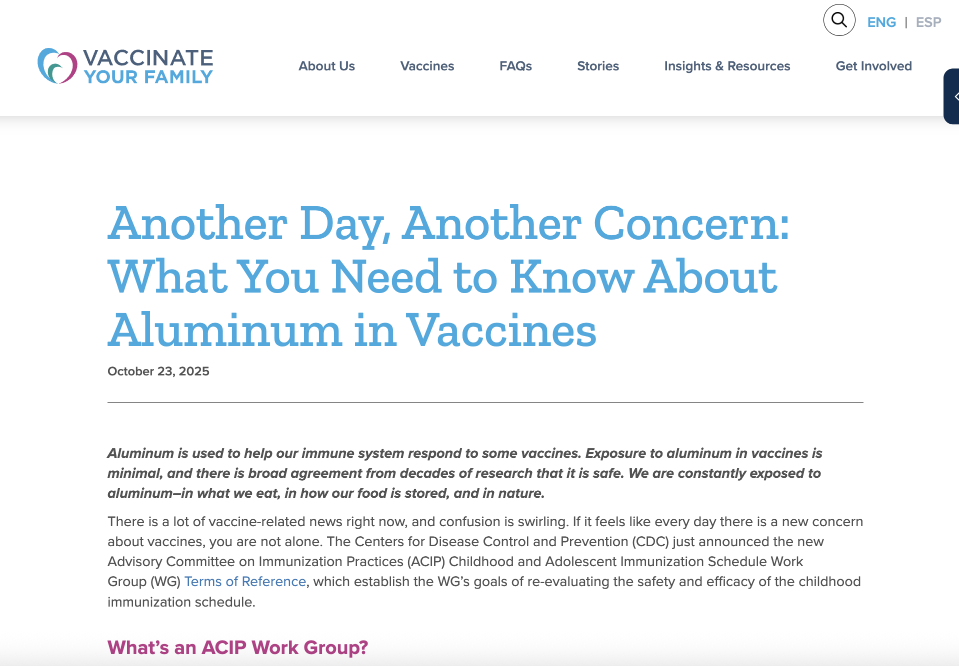
VACCINE COMMUNICATION RESOURCES
Tracking Hot Topics
Where to find talking points & resources to address trending vaccine claims
Vaccinate Your Family’s “Insights”: https://vaccinateyourfamily.org/news-resources/news/
ViralTruths.org

Slide 10


Thank you.
202.783.7034
info@vaccinateyourfamily.org
www.vaccinateyourfamily.org

